Slide 1

Customer Shopping Behavior Analysis
Analyzing 3,900 purchases to uncover insights into spending patterns, customer segments, and product preferences that drive strategic business decisions.

Slide 2
Dataset Overview
3,900
18
37
Total Purchases
Data Features
Missing Values
Transactions analyzed across various product categories
Columns capturing demographics, purchases, and behavior
Only in Review Rating column, handled via imputation
Key features include customer demographics (age, gender, location), purchase details (item, category, amount, season), and shopping behavior (discounts, previous purchases, review ratings, shipping type).

Slide 3

Data Preparation in Python
01
Data Loading & Exploration
Imported dataset using pandas, checked structure with df.info() and summary statistics
02
Missing Data Handling
Imputed Review Rating nulls using median rating per product category
03
Feature Engineering
Created age_group bins and purchase_frequency_days from transaction data
04
Database Integration
Connected to PostgreSQL and loaded cleaned DataFrame for SQL analysis

Slide 4
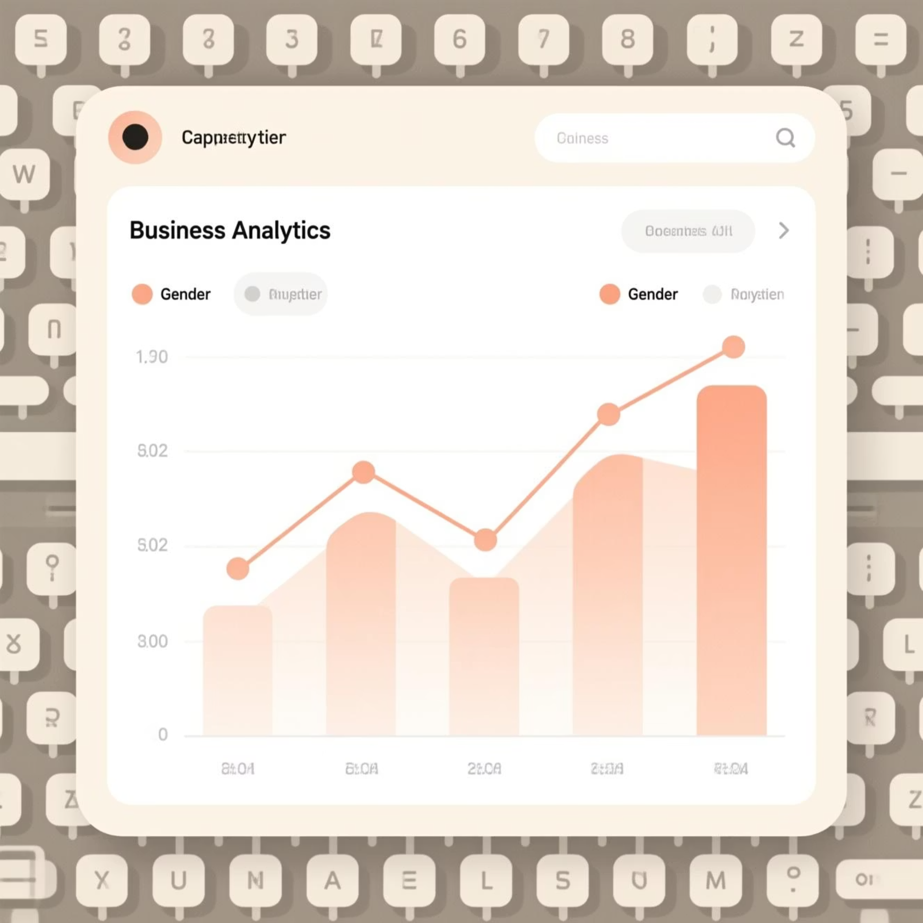
Revenue Analysis by Gender
Key Finding
Compared total revenue generated by male versus female customers to identify gender-based spending patterns and opportunities for targeted marketing campaigns.
This analysis helps optimize product positioning and promotional strategies for different customer segments.

Slide 5

Customer Spending Insights
High-Spending Discount Users
Top-Rated Products
Found the 5 products with highest average review ratings to guide inventory and marketing focus.
Identified customers who used discounts but still spent above average purchase amount—valuable segment for retention.
Shipping Preferences
Compared average purchase amounts between Standard and Express shipping to understand premium service adoption.

Slide 6
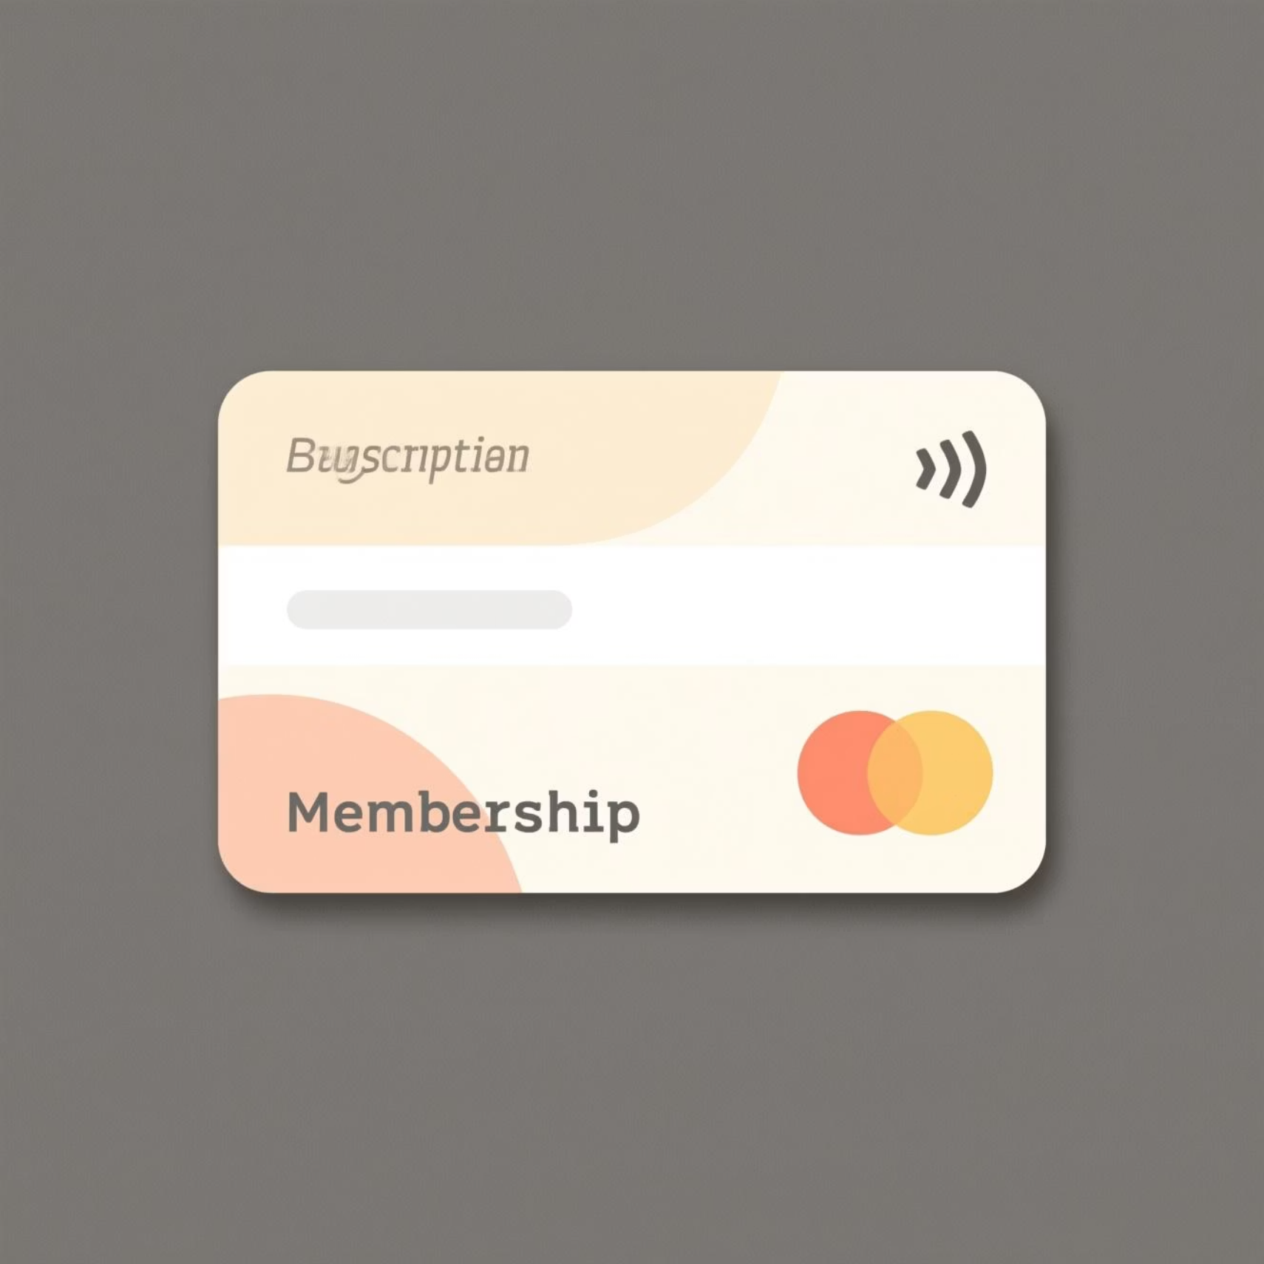
Subscription Impact
Subscribers vs. Non-Subscribers
Subscribers show higher average spend and contribute significantly more to total revenue.
Higher lifetime value
More consistent purchase patterns
Greater brand loyalty
Customers with more than 5 purchases are significantly more likely to subscribe, indicating strong correlation between repeat buying and subscription adoption.

Slide 7



Product & Discount Analysis
Discount-Dependent Products
Identified 5 products with highest percentage of discounted purchases—critical for pricing strategy.
Top Products per Category
Listed the 3 most purchased items within each category to optimize inventory and merchandising.

Slide 8



Customer Segmentation
1
Loyal
2
Returning
3
New
Classified customers into three segments based on purchase history. Loyal customers (frequent repeat buyers) represent the most valuable segment, followed by Returning customers showing engagement, and New customers entering the funnel.

Slide 9

Revenue by Age Group
Demographic Insights
Calculated total revenue contribution across age groups to identify highest-value demographics.
This analysis enables age-targeted marketing campaigns and product development aligned with generational preferences and spending power.

Slide 10
Strategic Recommendations
Boost Subscriptions
Customer Loyalty Programs
Review Discount Policy
Promote exclusive benefits for subscribers to increase recurring revenue and customer lifetime value.
Reward repeat buyers to move them into the "Loyal" segment and strengthen retention.
Balance sales boosts with margin control—optimize discount strategy for profitability.
Product Positioning
Targeted Marketing
Highlight top-rated and best-selling products in campaigns to drive conversion.
Focus efforts on high-revenue age groups and express-shipping users for maximum ROI.

